Slide 1
Azure Blob Containers

Slide 2
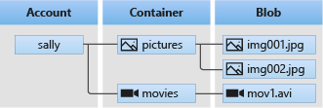
Azure Blob Containers
A scalable service to store unstructured data like text or any other binary data (images or videos).
Storage account sits on the top of the hierarchy.
Followed by containers, they organize the blobs like a directory or folder in a file system.
To access a container we use the URL –
https://<storage_account_name>.blob.core.windows.net/<container_name>
Blobs are the unstructured data residing under a container.
Blobs can be of 3 types –
Block Blobs – Made of blocks that can be managed independently. (E.g.: text files, images, etc.) It can grow up to 190.7 TiB.
Append Blobs – Same as block blobs but optimized for append operations. (E.g.: log files)
Page Blobs – Special type of blobs that support random access. (E.g.: Virtual machine disks) It can grow up to 8 TiB.
To access a blob inside of a container we use the URL –
https://<storage_account_name>.blob.core.windows.net/<container_name>/<blob_name>

Slide 3

Azure Blob Storage – Storage Types/Account Kind
Azure Blob Storage offers different storage types / account kinds each with different features and its own pricing models.
General Purpose V1 – GPv1 (Legacy)
BlobStorage – Legacy
General Purpose V2 – GPv2 (Current)
BlockBlobStorage
FileStorage

Slide 4
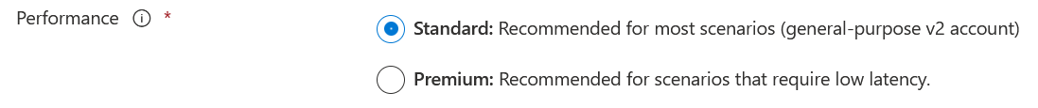
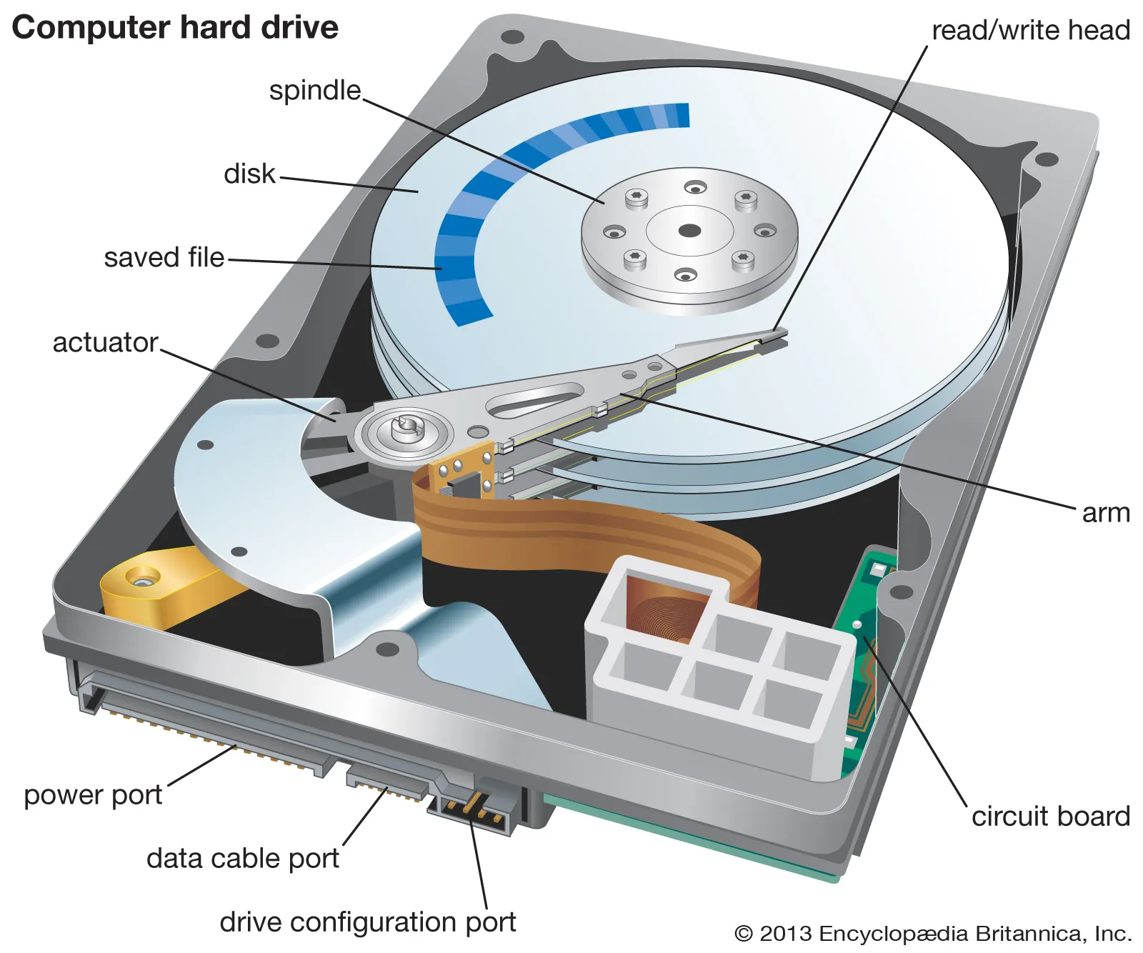
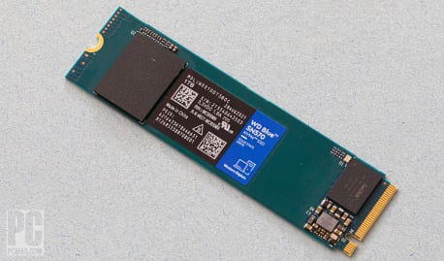
Azure Blob Storage – Performance Tiers
There are two types of performance tiers for Storage accounts.
Standard
Premium
Performance is measured on a metric called IOPS (Input Output Operations per second). The Higher the IOPS, the faster a drive can read and write.
Standard Performance | Premium Performance
Stored on Hard Disk Drives (HDDs) Performance depends on the access tier chosen (Hot, Cool, Archive). Use cases Static assets (images, videos, etc.) Backup and disaster recovery. Bulk data processing. A HDD has moving parts, an arm that needs to write data sequential to a disk. | Stored on Solid State Drives (SSDs) Optimized for low latency. Higher IOPS throughput. Use cases Data analytics. Training ML/DL models. Data transformation. A SSD has no moving parts, and data can be distributed randomly.

Slide 5
Azure Blob Storage – Access Tiers
There are 3 types of access tiers for Standard Performance Tier.
Hot (Default / Inferred)
Data that is accessed frequently.
Highest storage cost, lowest access cost.
Use cases
Data which is in active use and accessed frequently.
Data which is staged for eventual migration to the cool access tier.
Cool
Data that is accessed infrequently.
Lower storage cost, but higher access cost.
Data is deleted after 30 days being in the cool access tier.
Use cases
Short term disaster recovery backups.
Older infrequent data which needs access once in a while.
Archive
Data that is accessed rarely.
Lowest storage cost, highest access cost.
Data is deleted after 180 days being in the cool access tier.
Use cases
Long term backups / Secondary backups
Compliance and archival data which needs to be stored for long.

Slide 6
When moving a blob from archive access tier to a hotter tier it can take several hours, this process is called rehydrating.
When a blob is moved to another tier, its charged at the new tier’s rate immediately upon tier change.
When moving from a cooler tier to a hotter tier:
The operation is billed as a read operation to the destination tier.
Where the read operation (per 10000) and data write (per GiB) apply.
When moving from a hotter tier to a cooler tier:
The operation is billed as a write operation from the source tier.
Where the write operation (per 10000) and data write (per GiB) apply.
When the blob is deleted before the blob deletion period, an early deletion fee is charged.
If a blob moved to the cool tier is deleted at 21st day, then an early deletion fee of 9 days is charged.
If a blob moved to the archive tier is deleted at 45th day, then an early deletion fee of 135 days is charged.

Slide 7
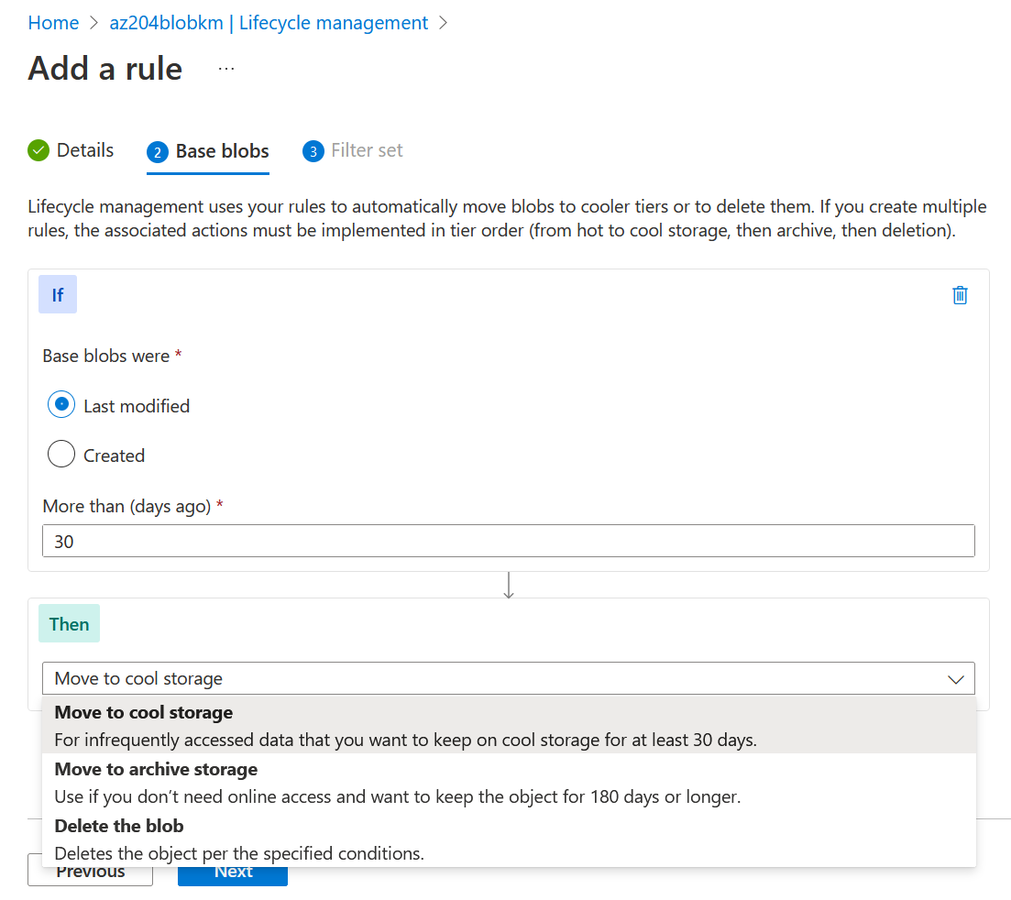
Azure Blob Storage – Lifecycle management
Lifecycle management offers a rule based policy to transition blob data to the appropriate access tiers or to delete the blob at the end of the elapsed time.
With the lifecycle management policy we can:
Transition blobs from cool to hot immediately when they are accessed to optimize performance.
Transition blobs from hot to cool tier if its not modified lately.
Delete blobs/blob snapshots/blob versions at the end of the elapsed time.
Rules can be applied on all the blobs or blobs matching the filters.

Slide 8
Azure Blob Containers Replication
Azure Blob Storage supports 6 replication levels with SLA ranging from 99.99999999999% (11 9s) to 99.9999999999999999% (16 9s) availability of your data.
Locally-redundant storage (LRS) – Least expensive
Zone-redundant storage (ZRS)
Geo-redundant storage (GRS)
Geo-zone-redundant storage (GZRS)

Slide 9
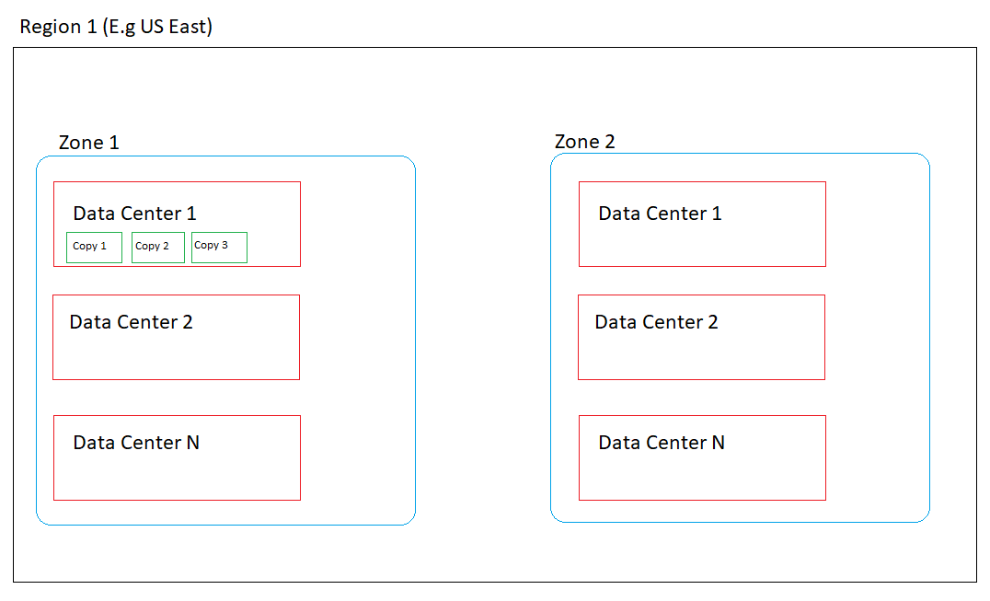
Locally-redundant storage (LRS)
Lowest cost replication option.
99.99999999999% (11 9s) SLA provided.
3 copies of data saved synchronously in a single data center (DC)
If DC downs, data is lost/irrecoverable.

Slide 10
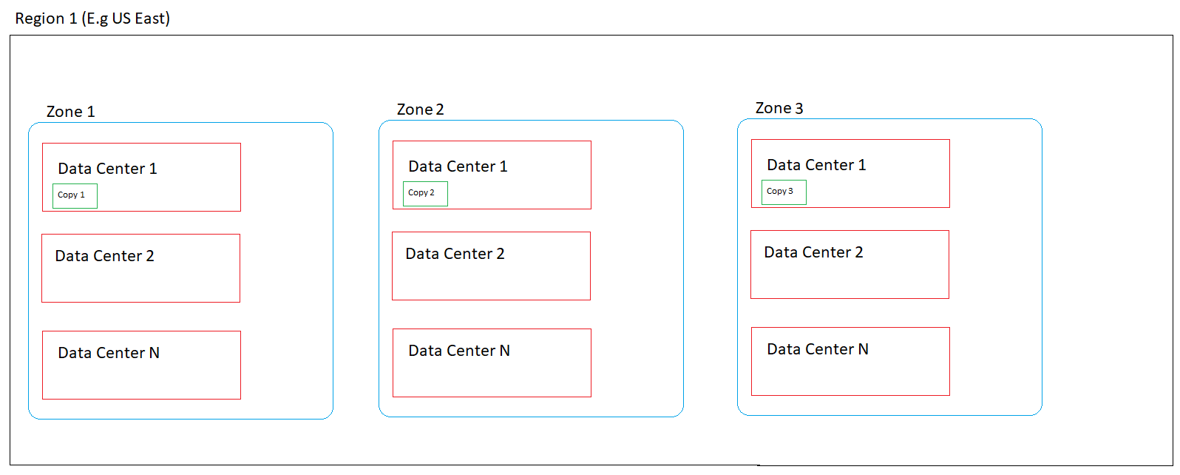
Zone-redundant storage (ZRS)
Microsoft recommends ZRS.
99.999999999999% (12 9s) SLA provided.
3 copies of data saved synchronously, 1 copy in each zone.
If DC down or Zone down data is still recoverable.
Not fool-proof as prone to regional disaster.
Data flow is synchronous because zones in a region are connected using very high-speed internet.

Slide 11
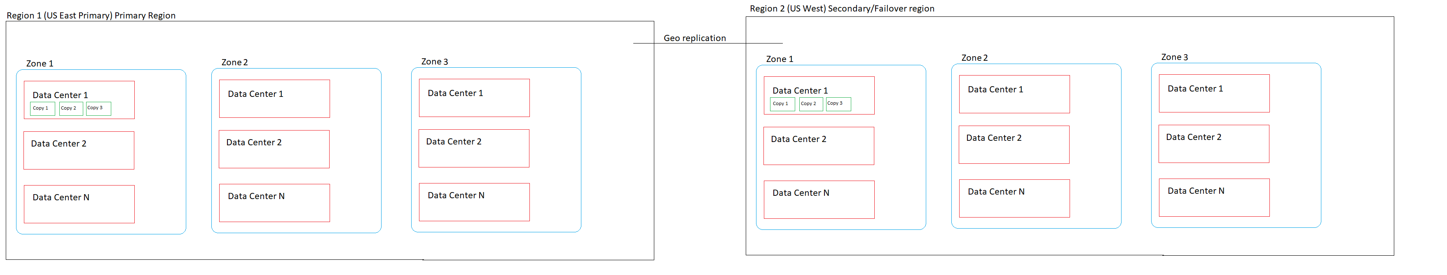
Geo-redundant storage (GRS)
3 Copies like LRS in a single region and 3 copies in another region.
Up to 99.99999999999999% (16 9’s) SLA.
Within the same region the replication is synchronous and within different regions it is asynchronous.
Can’t access data in secondary region unless there’s a failover.

Slide 12
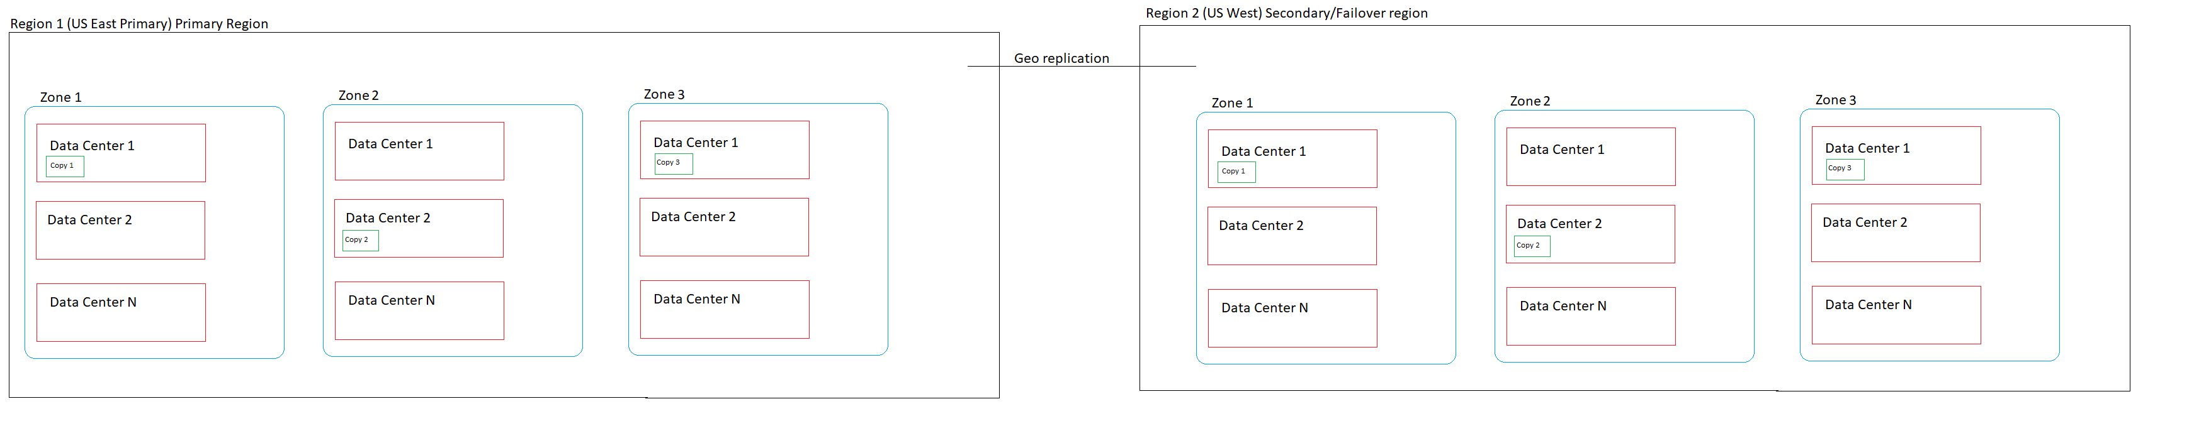
Geo-zone-redundant storage (GZRS)
3 Copies like LRS in a single region within different zones and 3 copies in another region.
Up to 99.99999999999999% (16 9’s) SLA.
Within the same region the replication is synchronous and within different regions it is asynchronous.
Can’t access data in secondary region unless there’s a failover.

Slide 13
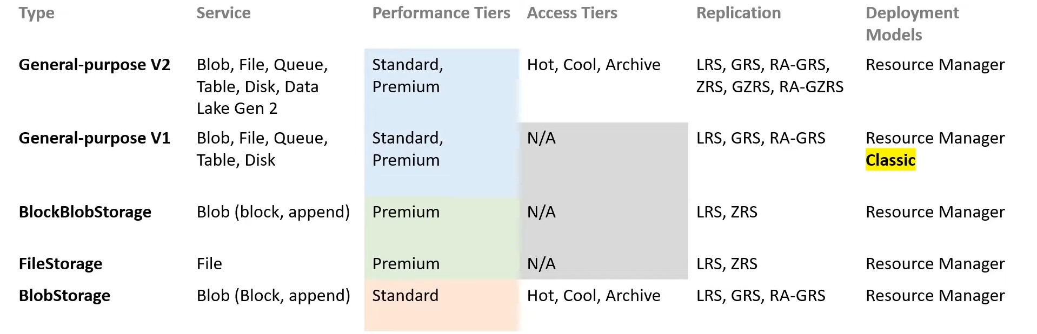
Review of Account Kind, Performance Tiers, Access Tiers and Replication

Slide 14
Azure Blob Storage Containers Pricing
Interactive pricing calculator for different azure regions can be viewed here.

Slide 15
Useful az-cli commands
Show the metadata of the container -
az storage container show --account-name $storageAccountName --name $containerName --account-key $accountKey
Update the metadata of the container -
az storage container metadata update --account-name $storageAccountName --name $containerName creationType=AzureCli --auth-mode key --account-key $accountKey
Show the metadata of the blob -
az storage blob metadata show --name $blobName --account-name $storageAccountName --containerName $containerName --metadata creationType=azurecli --auth-mode key --account-key $accountKey
Update the metadata of the blob -
az storage blob metadata update --name $blobName --account-name $storageAccountName --containerName $containerName --metadata creationType=azurecli --auth-mode key --account-key $accountKey

Slide 16
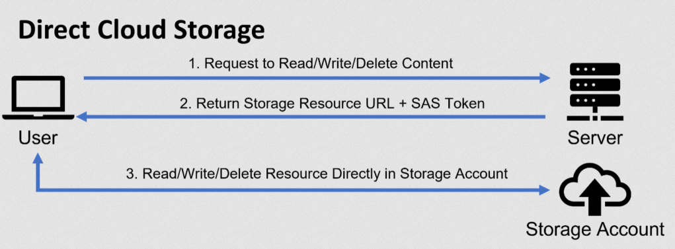
Shared Access Signature (SAS)
Shared access signatures provide an alternative for applications using Azure storage accounts.
Rather than handling uploads/downloads within the application, the application authorizes the client to store, retrieve and manage content within the cloud storage directly.
The SAS identifies the resource(s) to be accessed and includes the client’s proof of authorization.
The generated SAS URL can be accessed via HTTP PUT verb specifying the x-ms-blob-type: BlockBlob

Slide 17
Azure Storage Explorer
Electron.js based desktop tool to copy, view and list blobs in a container.
Download it here.

Slide 18
Azure Blob Storage C# SDK
Microsoft recommends Azure Blob Storage client library v12 for C#
Install-Package Azure.Storage.Blobs -Version 12.13.1
Register the BlobServiceClient as Singleton lifetime in the IoC container.
Client methods are thread-safe.

Slide 19
Demo

